Slide 1

Health Disparities Research
Module 4
Genetic diversity & population structure
Session 7

Slide 2
Session 7 overview
What do we mean by genetic diversity?
Brief history of humanity
What is genetic ancestry?
Why is it relevant for health disparities?

Slide 3
What is genetic diversity?

Slide 4
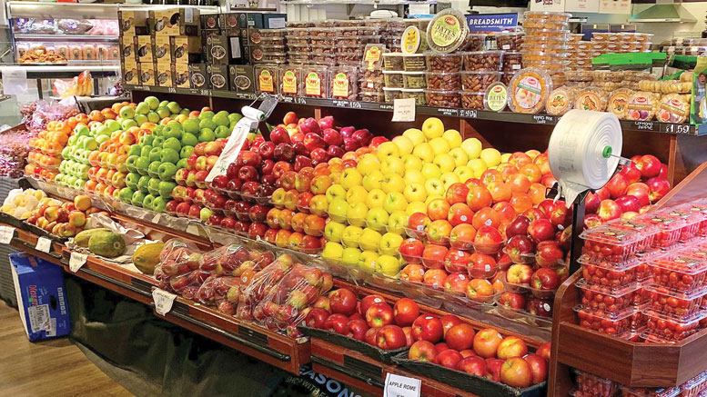
Genetic diversity
Base definition:
The total number of genetic characteristics in the genetic makeup of a species
Let’s start with an example:
Apples at a grocery store
All the same species, but very different flavors and textures owing to small genetic differences

Slide 5
How do we get genetic diversity?
Key processes that lead to the generation of genetic diversity
Errors in DNA replication
Recombination (sexual reproduction)
These newly introduced variants change in frequency in different groups over time owing to non-random mating

Slide 6
Genetic diversity: what does it mean for humans?
Historically (and now), individuals across the world do not choose their reproductive partners at random from the entire world
This non-random mating is referred to as population structure
This leads to differences in allele frequencies over time
Human populations are structured at many levels
Continents
Geographical regions
Often even between different villages of the same ethnic group

Slide 7
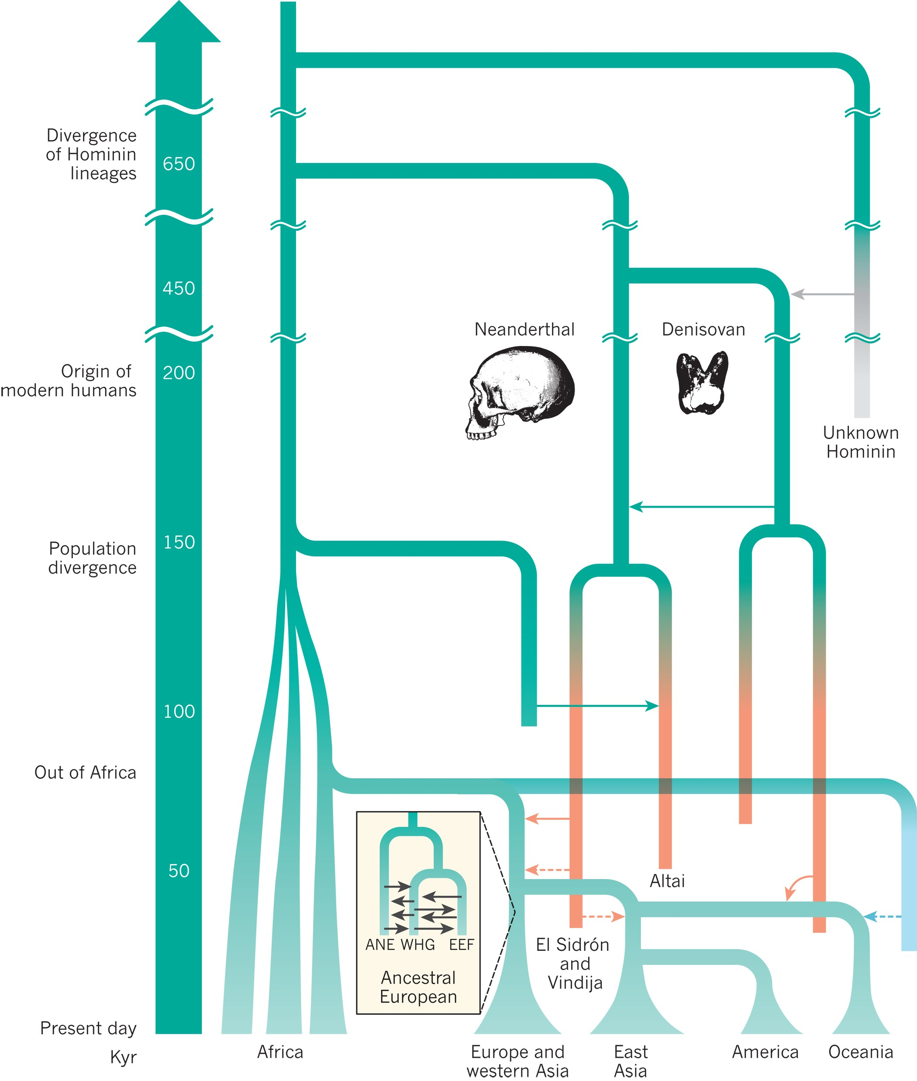
A brief history of humanity
Modern humans have descended from ancestral populations in sub-Saharan Africa
Non-African populations also have some ancestry from other archaic humans (like Neanderthals and Denisovans)
We’re a fairly young species – so we share a lot of genetic variation

Slide 8
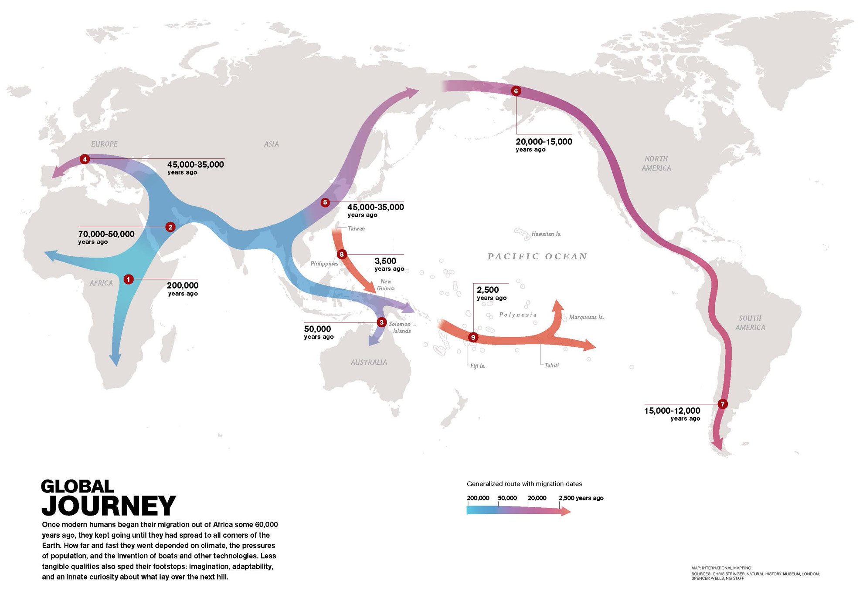
The (modern) human odyssey
Source: Nat Geo

Slide 9
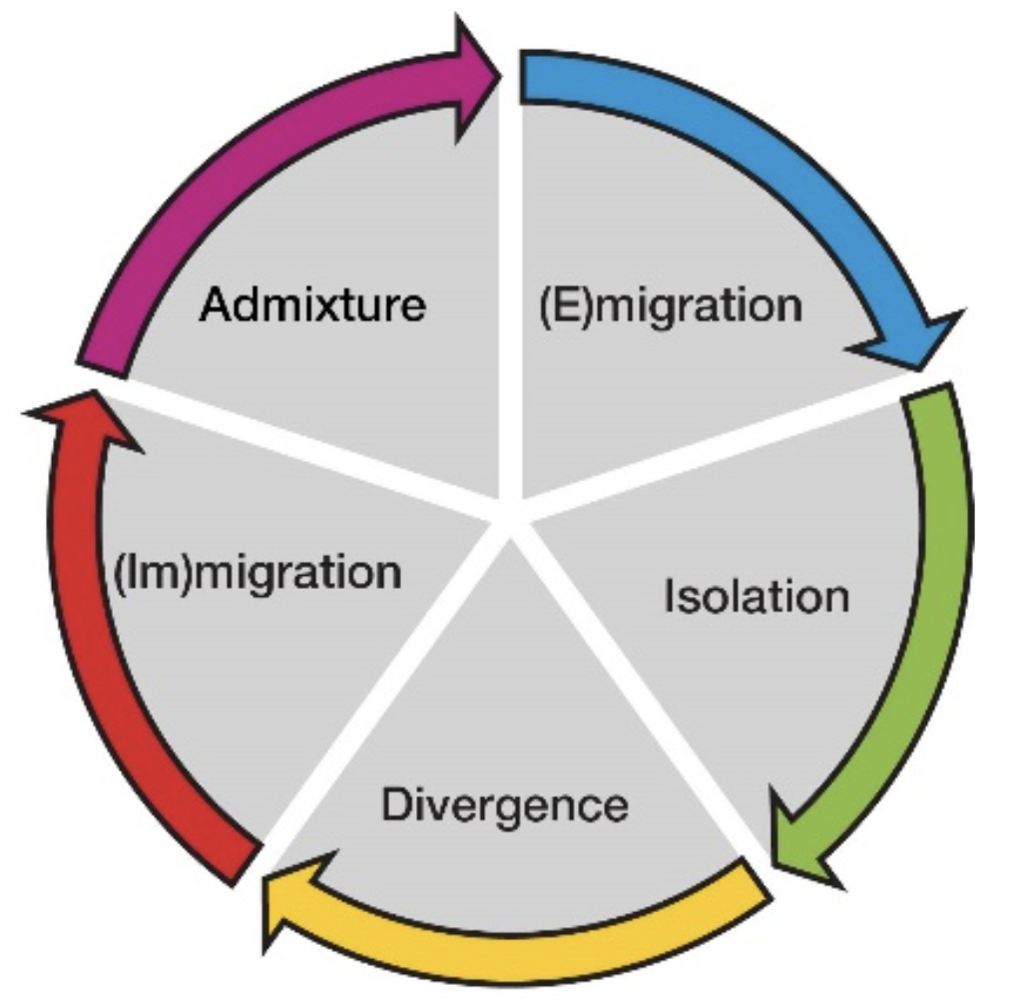
What shapes genetic diversity?

Slide 10
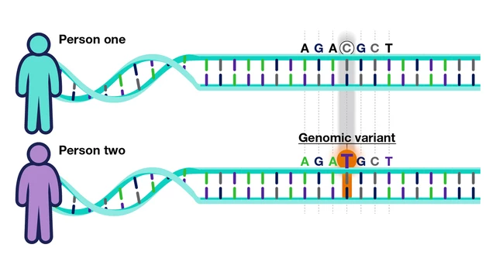
Quick detour: operationalizing genetic variants
We represent genetic variants as different versions of the same allele at a given position on the reference genome
Single Nucleotide Polymorphism

Slide 11
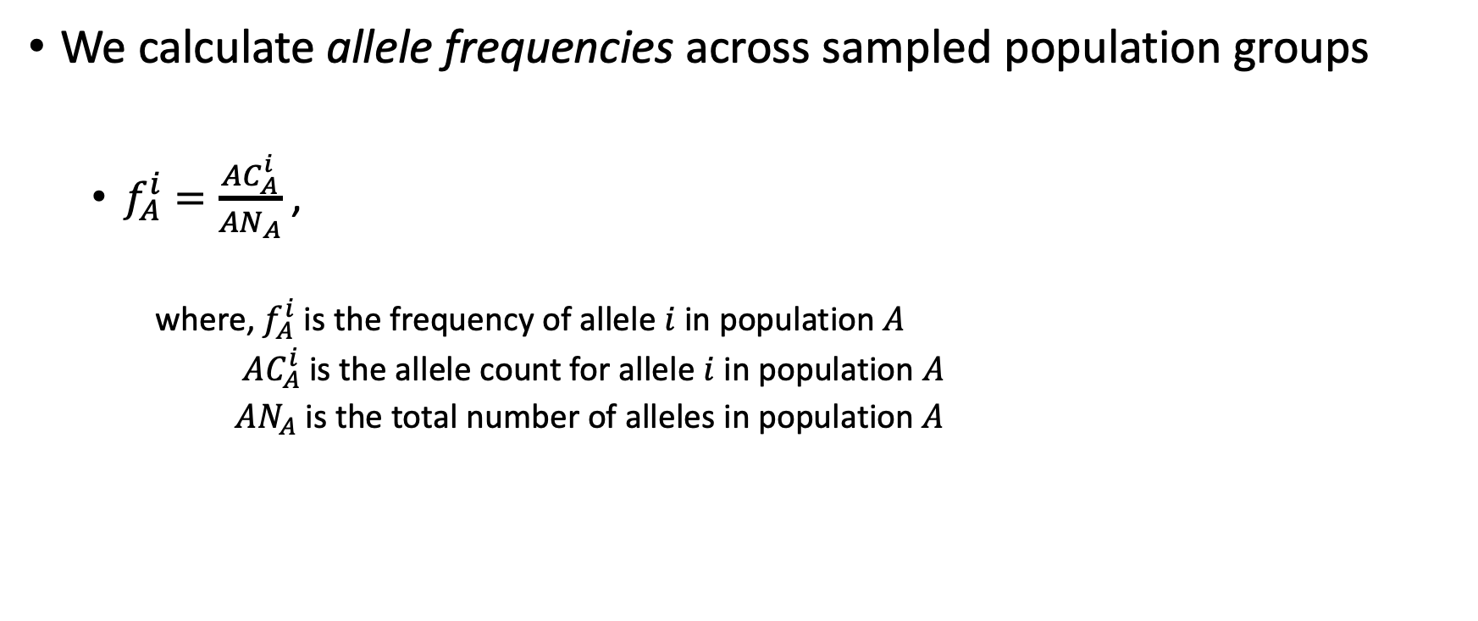
Quick detour: operationalizing genetic variants
We calculate allele frequencies across sampled population groups
$f_{A}^{i}=\frac{AC_{A}^{i}}{AN_{A}}$,
where, $f_{A}^{i}$is the frequency of allele $i$ in population $A$
$AC_{A}^{i}$ is the allele count for allele $i$ in population $A$
$AN_{A}$ is the total number of alleles in population $A$

Slide 12
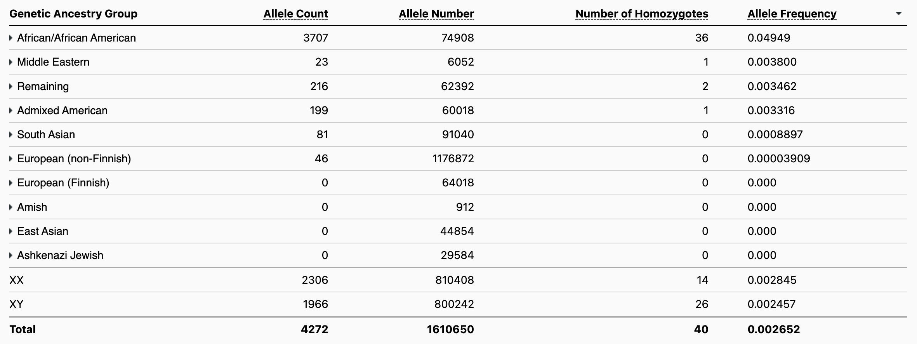
Quick detour: operationalizing genetic variants
We calculate allele frequencies across sampled population groups
rs334 – SNP associated with sickle cell anemia
https://gnomad.broadinstitute.org/variant/11-5227002-T-A?dataset=gnomad_r4

Slide 13
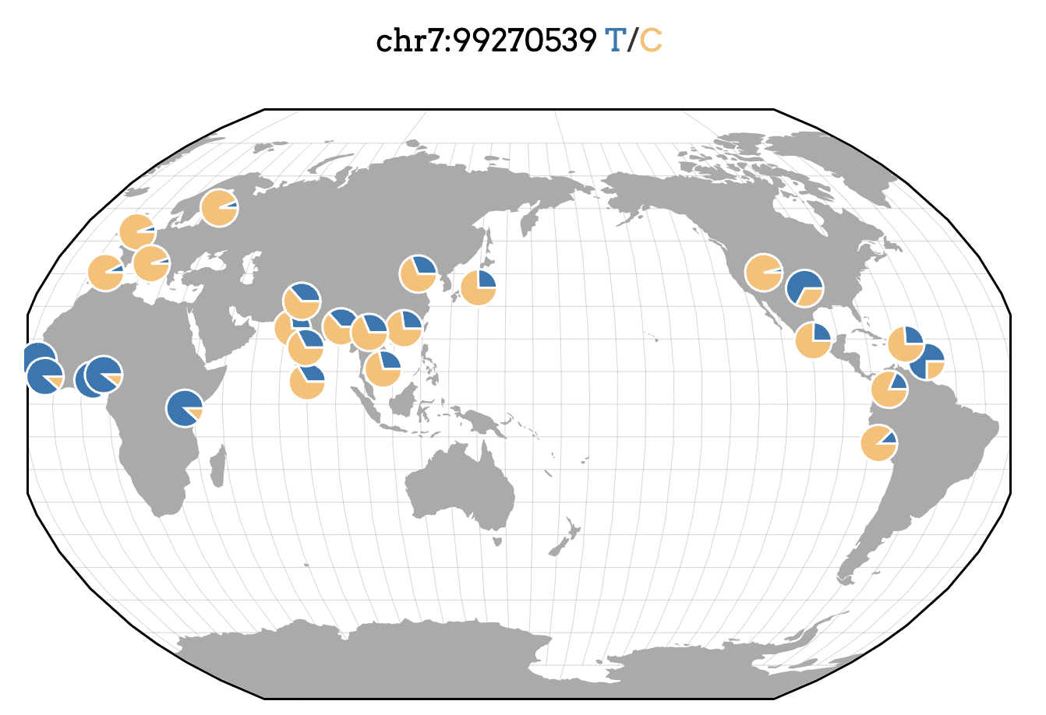
Quick detour: operationalizing genetic variants
Variant associated with the metabolism of tacrolimus – a post-transplant immuno-suppressant
Source: GGV

Slide 14
Wait: how do we make these groups?
How do we define populations?
What forms the boundary?
What are the factors that can change these designations?

Slide 15
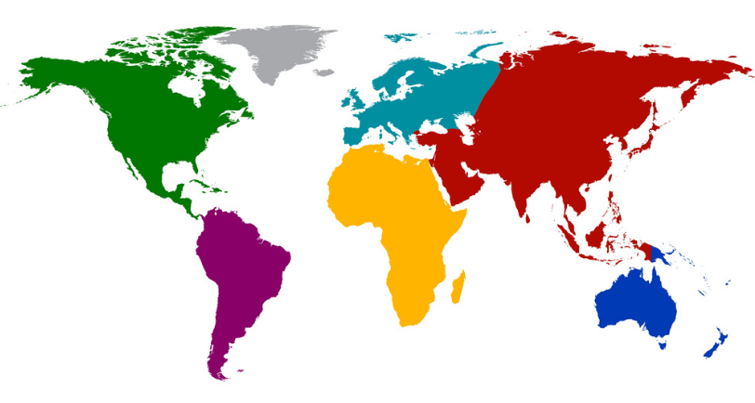
Ancestry
Geographic origins of a person’s ancestors
Impacts health (disparities) in a variety of different ways
Can be defined
Socially
Genetically

Slide 16
Socially defined ancestry
Defined at two levels:
Government bureaucrats decide on ancestry categories
Race & Ethnicity
Change over time and space
Individuals self-identify according to those categories

Slide 17

Race and ethnicity in the US
Race designations in the US are based on individuals self-identifying as having origins in population groups that correspond to broad geographic regions
Ethnicity in the US census is narrowly defined as either having a Hispanic origin or not
White – A person having origins in any of the original peoples of Europe, the Middle East, or North Africa.
Black or African American – A person having origins in any of the Black racial groups of Africa.
American Indian or Alaska Native – A person having origins in any of the original peoples of North and South America (including Central America) and who maintains tribal affiliation or community attachment.
Asian – A person having origins in any of the original peoples of the Far East, Southeast Asia, or the Indian subcontinent including, for example, Cambodia, China, India, Japan, Korea, Malaysia, Pakistan, the Philippine Islands, Thailand, and Vietnam.
Native Hawaiian or Other Pacific Islander – A person having origins in any of the original peoples of Hawaii, Guam, Samoa, or other Pacific Islands.
https://www.census.gov/topics/population/race/about.html
https://www.census.gov/topics/population/hispanic-origin/about.html

Slide 18
Ethnicity in the UK
White
British
Irish
Any other white background
Mixed
White and Black Caribbean
White and Black African
White and Asian
Any other mixed background
Asian or Asian British
Indian
Pakistani
Bangladeshi
Any other Asian background
Black or Black British
Caribbean
African
Any other Black background
Chinese
Other ethnic group
In the UK, ethnic groups are used in a way that is analogous to racial groups in the US
According to the Office for National Statistics in the UK, Elements that shape someone’s ethnicity include:
Common ancestry
Elements of culture
Religion
Language
Physical appearance
Source: UK Biobank
https://gss.civilservice.gov.uk/policy-store/ethnicity/

Slide 19
Socially defined ancestry: variability by locale
Race and ethnicity are socially defined, and the definitions often vary by country
United States | United Kingdom
Race designations in the US are based on individuals self-identifying as having origins in population groups that correspond to broad geographic regions Ethnicity in the US census is narrowly defined as either having a Hispanic origin or not | Ethnic groups are used in a way that is analogous to racial groups in the US
United States | United Kingdom
Race White Black or African American American Indian or Alaska Native Asian Native Hawaiian or Other Pacific Islander Ethnicity Hispanic/Latino Not Hispanic/Latino | Ethnic groups White Asian or Asian British Black or Black British Chinese Mixed Other ethnic group
Asian – A person having origins in any of the original peoples of the Far East, Southeast Asia, or the Indian subcontinent including, for example, Cambodia, China, India, Japan, Korea, Malaysia, Pakistan, the Philippine Islands, Thailand, and Vietnam.
Asian or Asian British
Indian
Pakistani
Bangladeshi
Any other Asian background
https://www.census.gov/topics/population/race/about.html
https://www.census.gov/topics/population/hispanic-origin/about.html
https://gss.civilservice.gov.uk/policy-store/ethnicity/

Slide 20
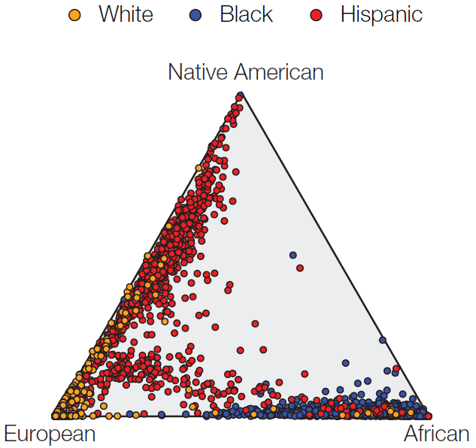
Genetically inferred ancestry
Self-Identified Race/Ethnicity Group
We can define genetic ancestry (GA) with confidence and precision
Categorical and continuous variable
Characteristic of the genome
Independent of the social dimension of race/ethnicity groups
Nagar et al., 2020. BMC Biology.

Slide 21
Ancestral origins are important for health disparities research
Ancestral origins is used here to include both genetic ancestry and self-identified race/ethnicity
Genetic ancestry (GA) represents systematic allele frequency differences among populations
Self-identified race/ethnicity (SIRE) represents social experiences
Depending on definitions, SIRE and GA may be correlated for certain groups

Slide 22
Using genomic data to characterize diversity
How can we use genomic information from many individuals from different populations?
What can it help us learn about population structure?

Slide 23
Heterozygosity as a measure of diversity
Maternal copy
T
A
Paternal copy
G
A
Heterozygous
Homozygous
Higher heterozygosity → higher genetic diversity

Slide 24
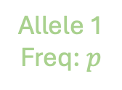
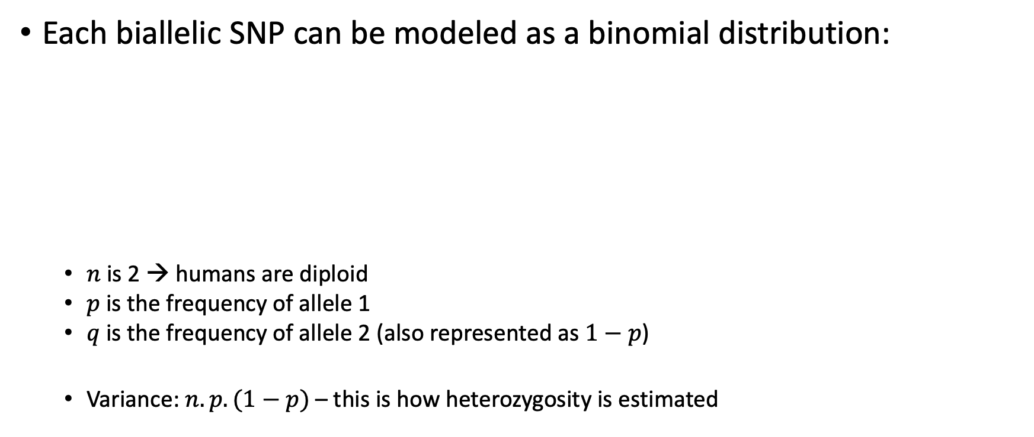
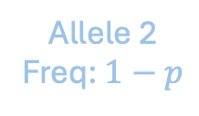
Statistical intuition for population heterozygosity
Each biallelic SNP can be modeled as a binomial distribution:
$n$ is 2 → humans are diploid
$p$ is the frequency of allele 1
$q$ is the frequency of allele 2 (also represented as $1−p$)
Variance: $n.p.(1−p)$ – this is how heterozygosity is estimated
Allele 2
Freq: $1−p$
rsID
Genomic Location
rs334 chr11 : 5,227,002 : T : A
Allele 1
Freq: $p$

Slide 25
Heterozygosity estimates by population
Region | Population | Heterozygosity Estimate*
African | San | 0.95
 | Yoruba | 0.96
Near East | Palestinian | 0.73
 | Iranian | 0.71
Europe | Spanish | 0.69
 | Polish | 0.67
South Asia | Punjabi | 0.71
 | Bengali | 0.72
East Asian | Thai | 0.69
 | Japanese | 0.67
Oceania | Australian Indigenous | 0.63
 | Papuan | 0.58
Americas | Inuit | 0.63
 | Surui | 0.50
As migration distance from Africa increases, heterozygosity decreases
This reflects that modern humans evolved in Africa and eventually peopled the rest of the world
*Adapted from Mallick et al., 2017. Nature.

Slide 26
Quick detour: linkage disequilibrium (LD)
Another important concept to know before we start treating genomic data like any other piece of data is linkage disequilibrium (LD)
“Linkage disequilibrium (LD) is one of those unfortunate terms that does not reveal its meaning. As every instructor of population genetics knows, the term is a barrier not an aid to understanding.”
- Montgomery Slatkin (Slatkin. 2008. Nature Reviews Genetics)

Slide 27
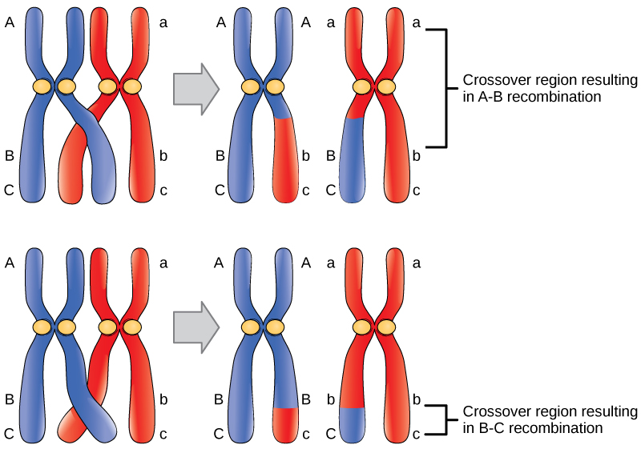
Recombination refresher

Slide 28
Quick detour: linkage disequilibrium (LD)
3 Different Alleles
But this isn’t a population genetics course, sensu strictu
Simply put:
LD is the non-random association of alleles at 2 (or more) loci
This may or may not be related to physical linkage

Slide 29
Quick detour: linkage disequilibrium (LD)
A lot of statistical analyses rely on independent parameters
LD-pruning – removing linked variants – allows us to generate a dataset that can be used for downstream statistical analyses

Slide 30
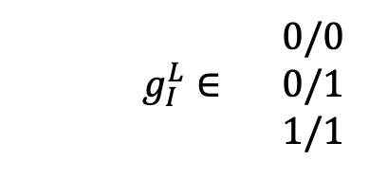
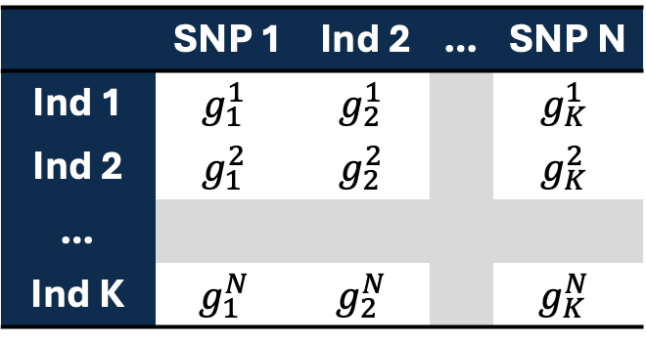
Representing genomic data
 | SNP 1 | Ind 2 | … | SNP N
Ind 1 | $$g_{1}^{1}$$ | $$g_{2}^{1}$$ |  | $$g_{K}^{1}$$
Ind 2 | $$g_{1}^{2}$$ | $$g_{2}^{2}$$ |  | $$g_{K}^{2}$$
…
Ind K | $$g_{1}^{N}$$ | $$g_{2}^{N}$$ |  | $$g_{K}^{N}$$
Matrix Representation of Genotypes
0/0
$g_{I}^{L}∈$ 0/1
1/1

Slide 31
Representing genomic data
 | SNP 1 | Ind 2 | … | SNP N
Ind 1 | 0 | 0 |  | 1
Ind 2 | 2 | 0 |  | 1
…
Ind K | 1 | 2 |  | 0
Matrix Representation of Genotypes
0 → homozygous reference
1 → heterozygous
2 → homozygous alternate

Slide 32
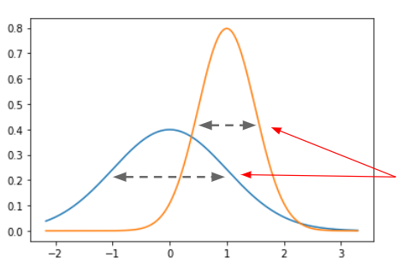
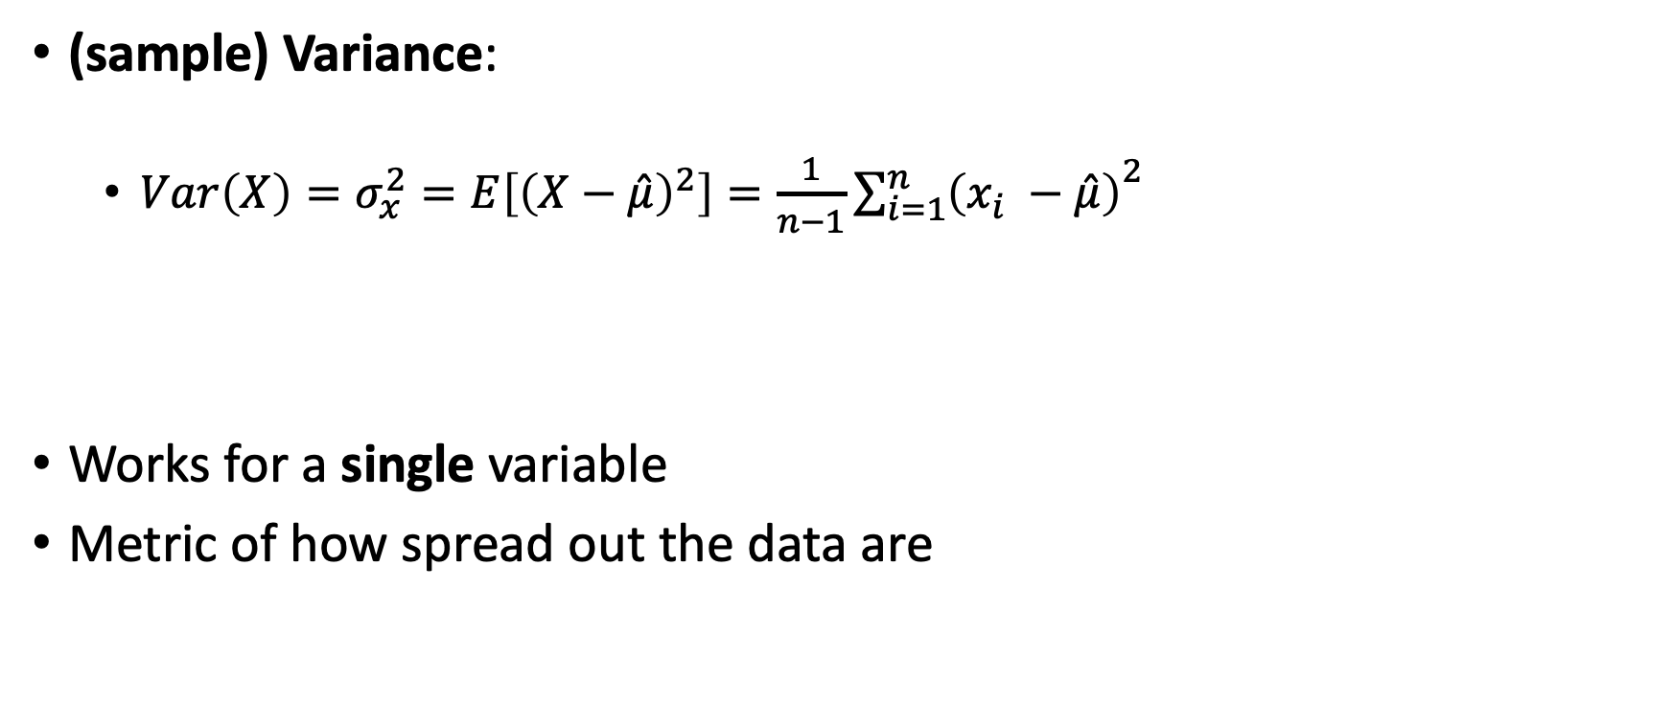
Concepts: variance, covariance, and correlation
(sample) Variance:
$Var\left(X\right)=σ_{x}^{2}=E\left[{\left(X−\hat{μ}\right)}^{2}\right]=\frac{1}{n−1}{\sum_{i=1}^{n}{\left(x_{i} −\hat{μ}\right)}}^{2}$
Works for a single variable
Metric of how spread out the data are
Image source

Slide 33
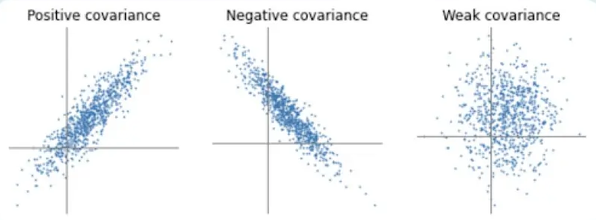
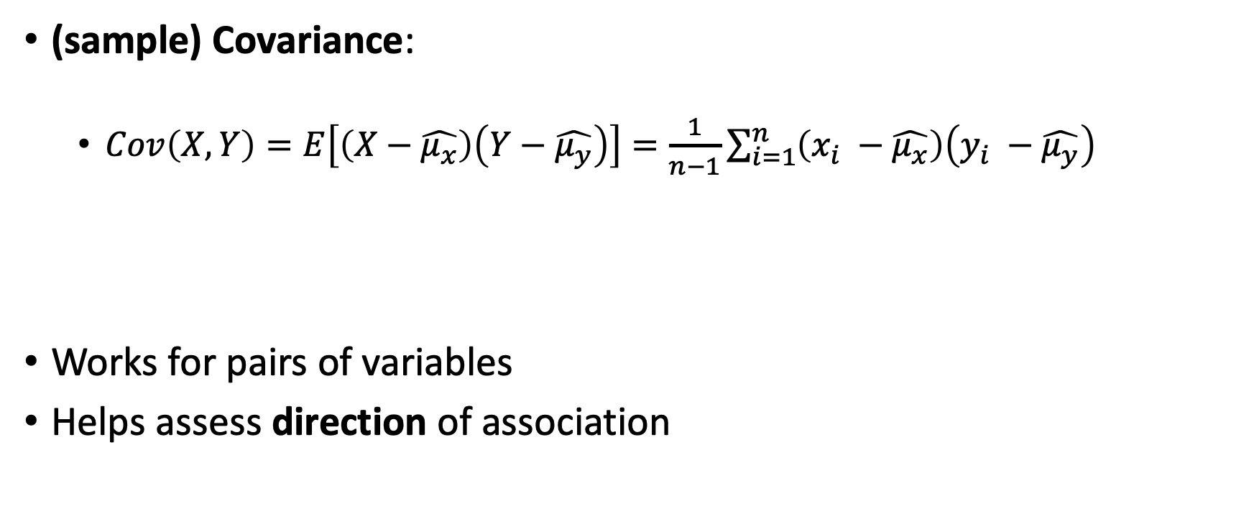
Concepts: variance, covariance, and correlation
(sample) Covariance:
$Cov\left(X, Y\right)=E\left[\left(X−\hat{μ_{x}}\right)\left(Y−\hat{μ_{y}}\right)\right]=\frac{1}{n−1}\sum_{i=1}^{n}{\left(x_{i} −\hat{μ_{x}}\right)\left(y_{i} −\hat{μ_{y}}\right)}$
Works for pairs of variables
Helps assess direction of association

Slide 34
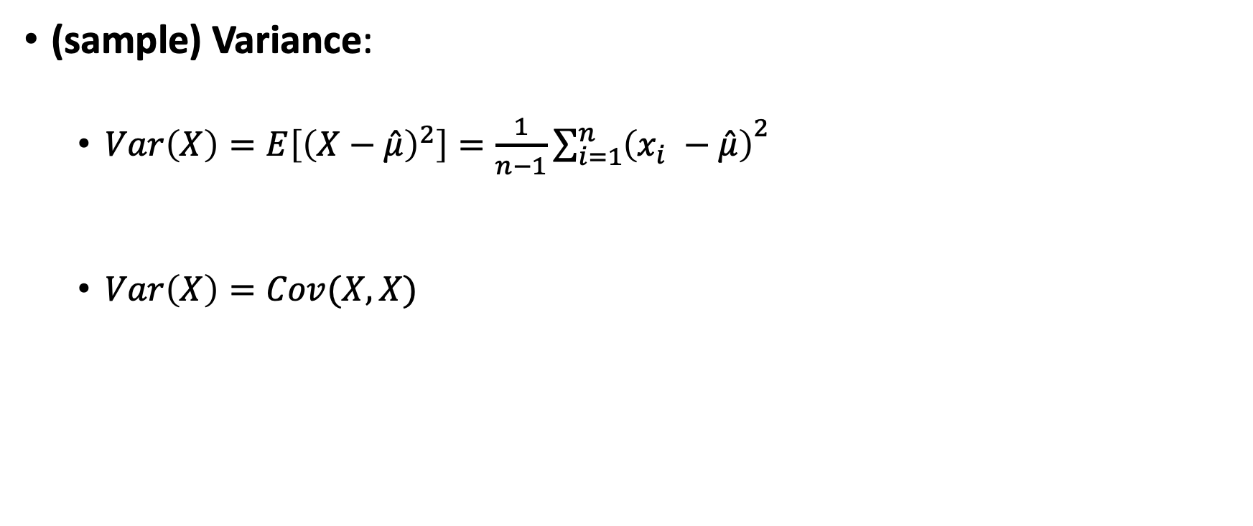
Concepts: variance, covariance, and correlation
(sample) Variance:
$Var\left(X\right)=E\left[{\left(X−\hat{μ}\right)}^{2}\right]=\frac{1}{n−1}{\sum_{i=1}^{n}{\left(x_{i} −\hat{μ}\right)}}^{2}$
$Var\left(X\right)=Cov(X,X)$

Slide 35
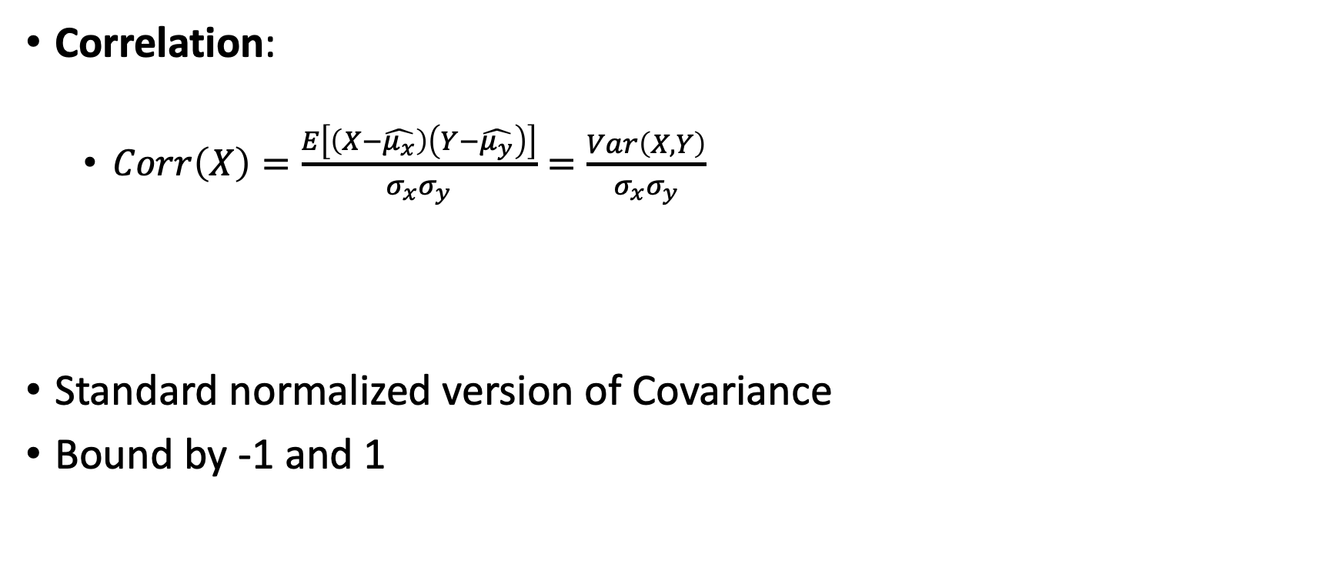
Concepts: variance, covariance, and correlation
Correlation:
$Corr\left(X\right)=\frac{E\left[\left(X−\hat{μ_{x}}\right)\left(Y−\hat{μ_{y}}\right)\right]}{σ_{x}σ_{y}}=\frac{Var\left(X,Y\right)}{σ_{x}σ_{y}}$
Standard normalized version of Covariance
Bound by -1 and 1

Slide 36
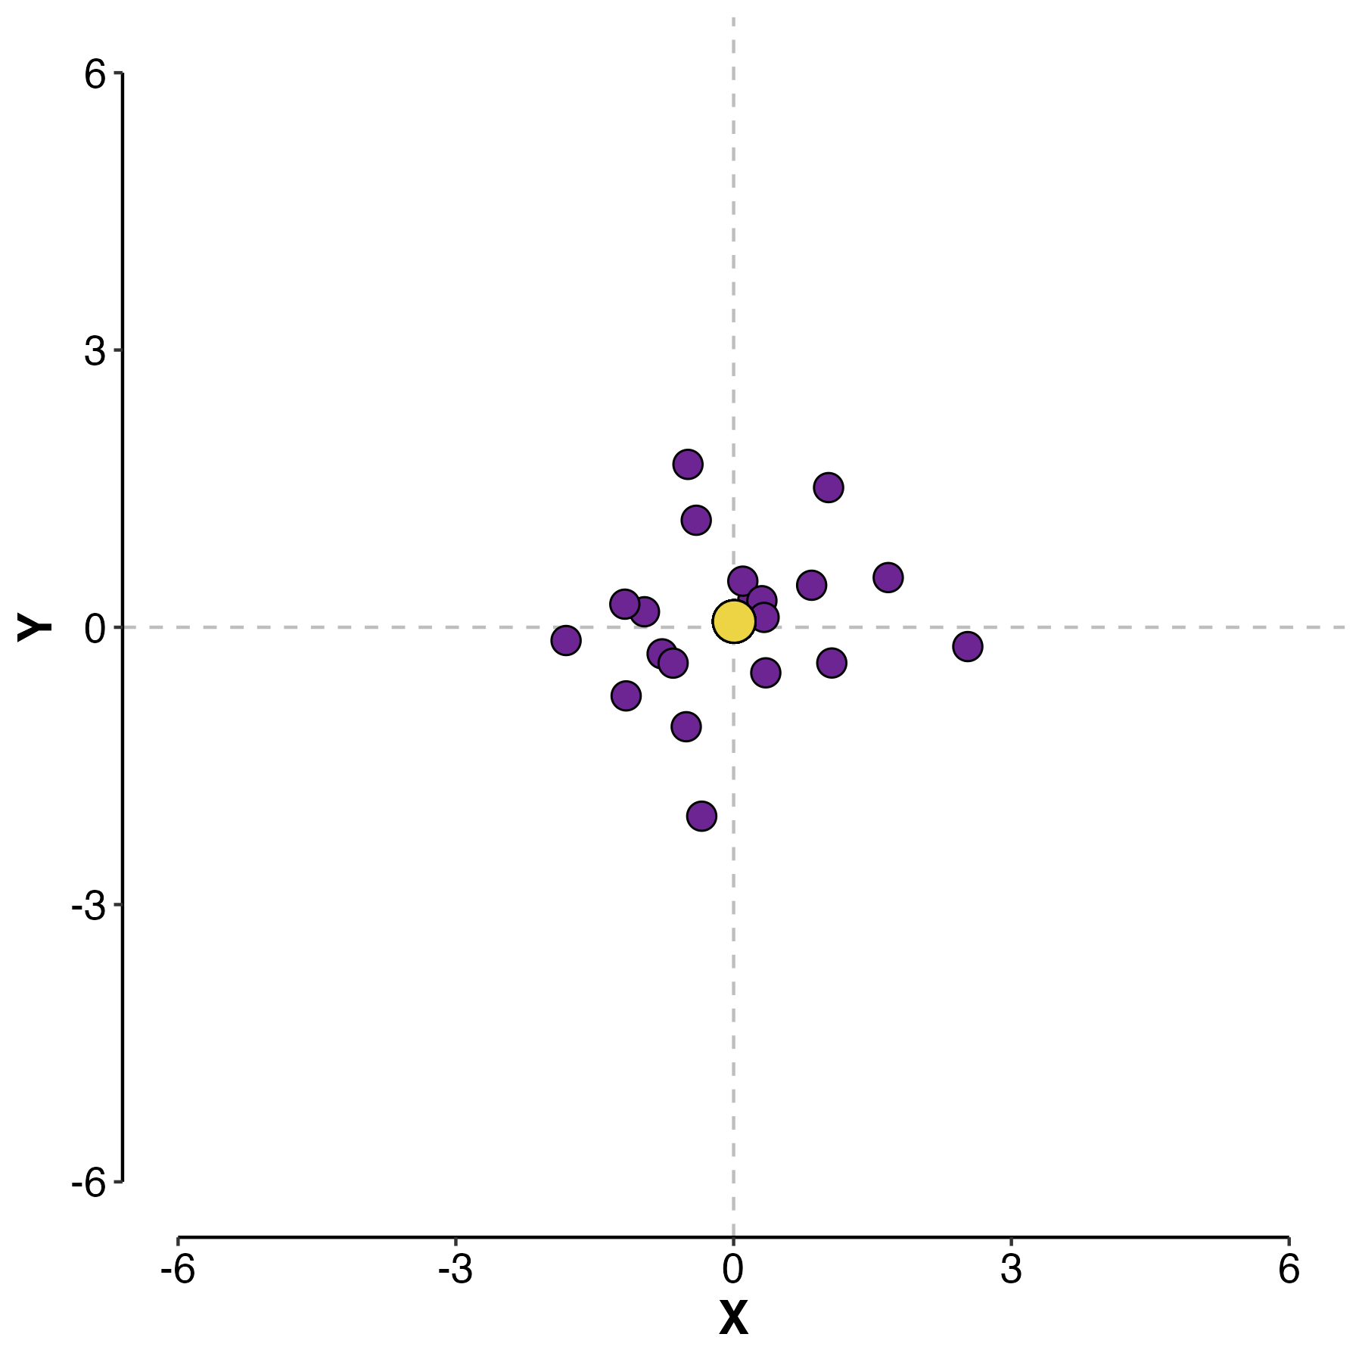
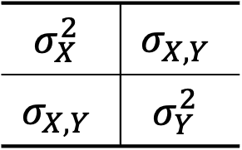
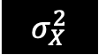
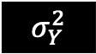
Developing an intuition for covariance
$$σ_{X}^{2}$$ | $$σ_{X,Y}$$
$$σ_{X,Y}$$ | $$σ_{Y}^{2}$$
$$σ_{Y}^{2}$$
1 | 0
0 | 1
$$σ_{X}^{2}$$
Data point
Mean

Slide 37
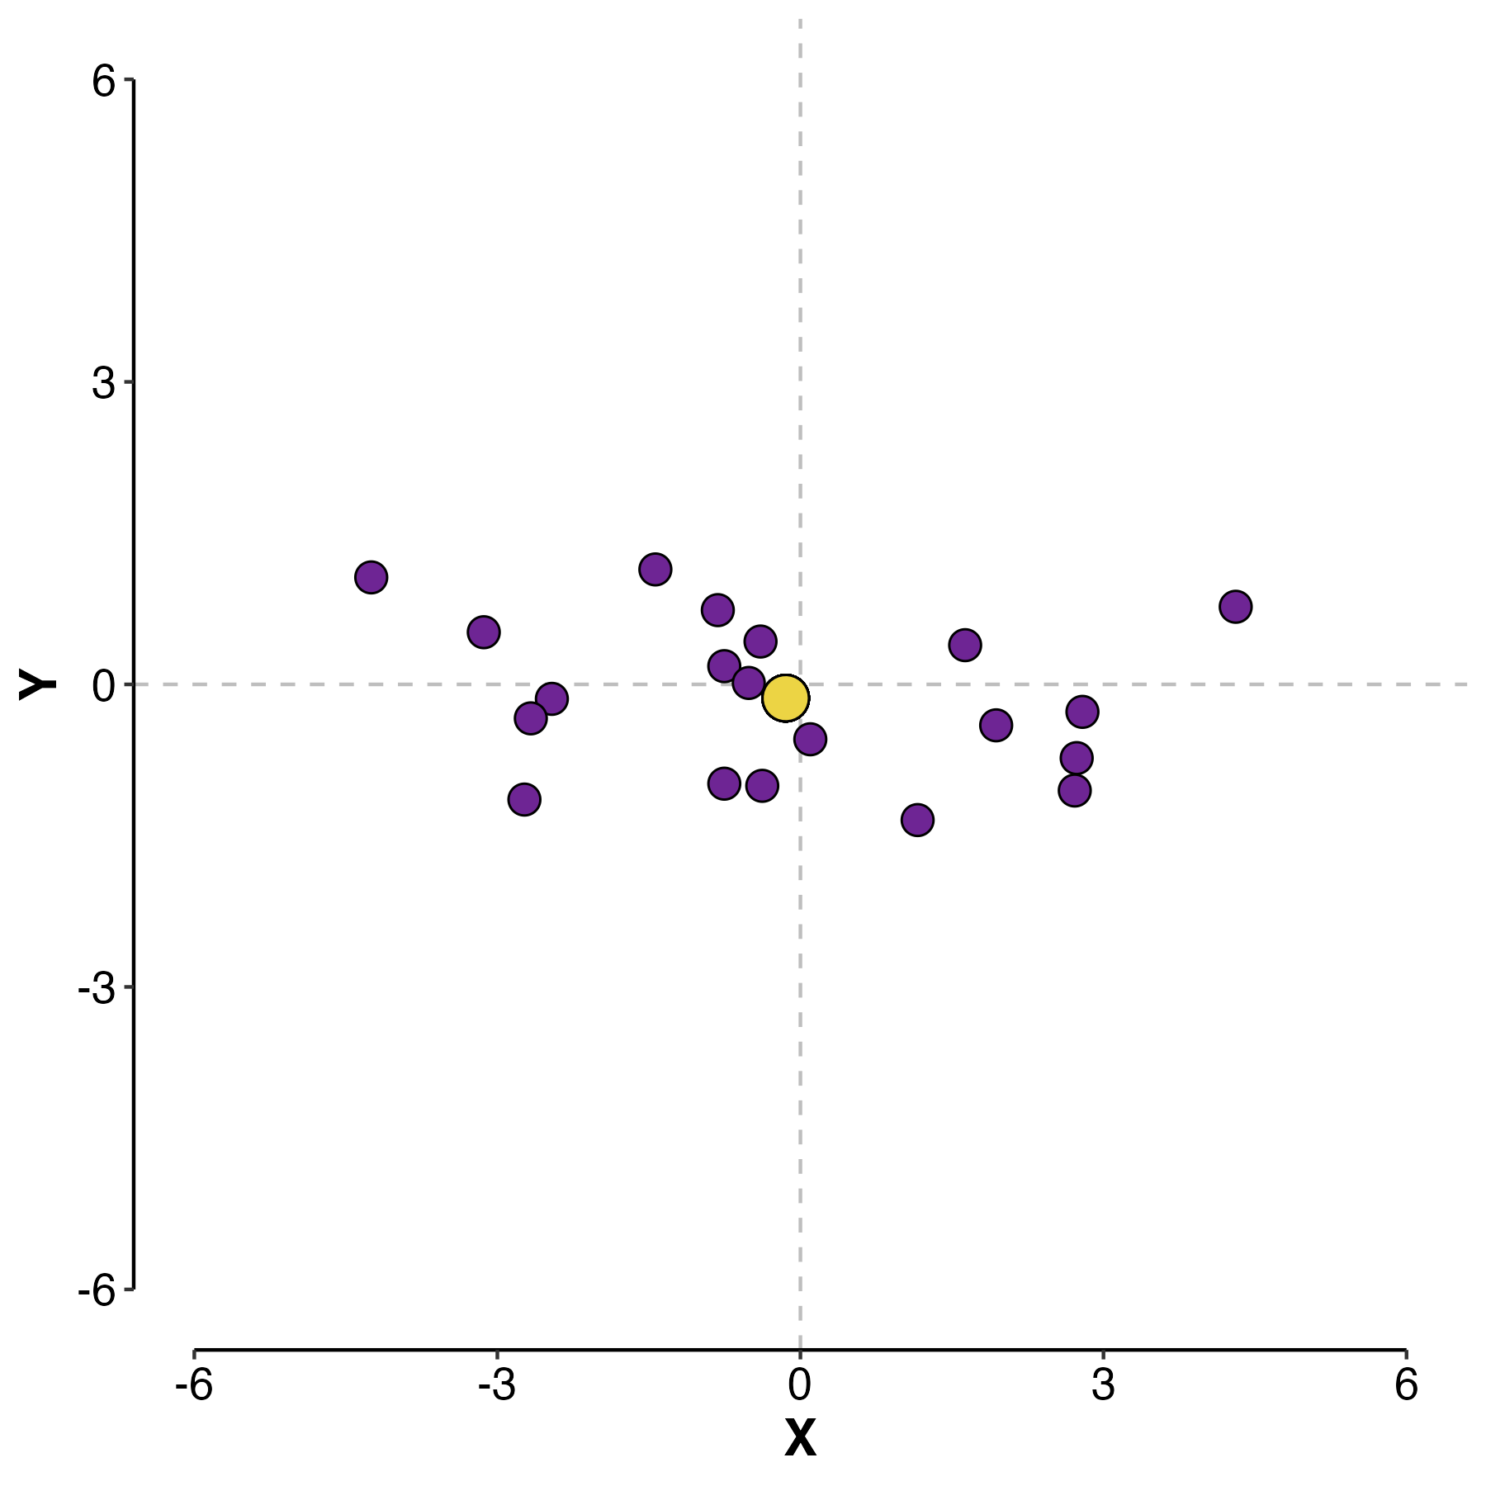

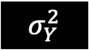
Developing an intuition for covariance
$$σ_{X}^{2}$$ | $$σ_{X,Y}$$
$$σ_{X,Y}$$ | $$σ_{Y}^{2}$$
$$σ_{Y}^{2}$$
7 | 0
0 | 1
$$σ_{X}^{2}$$
Data point
Mean

Slide 38
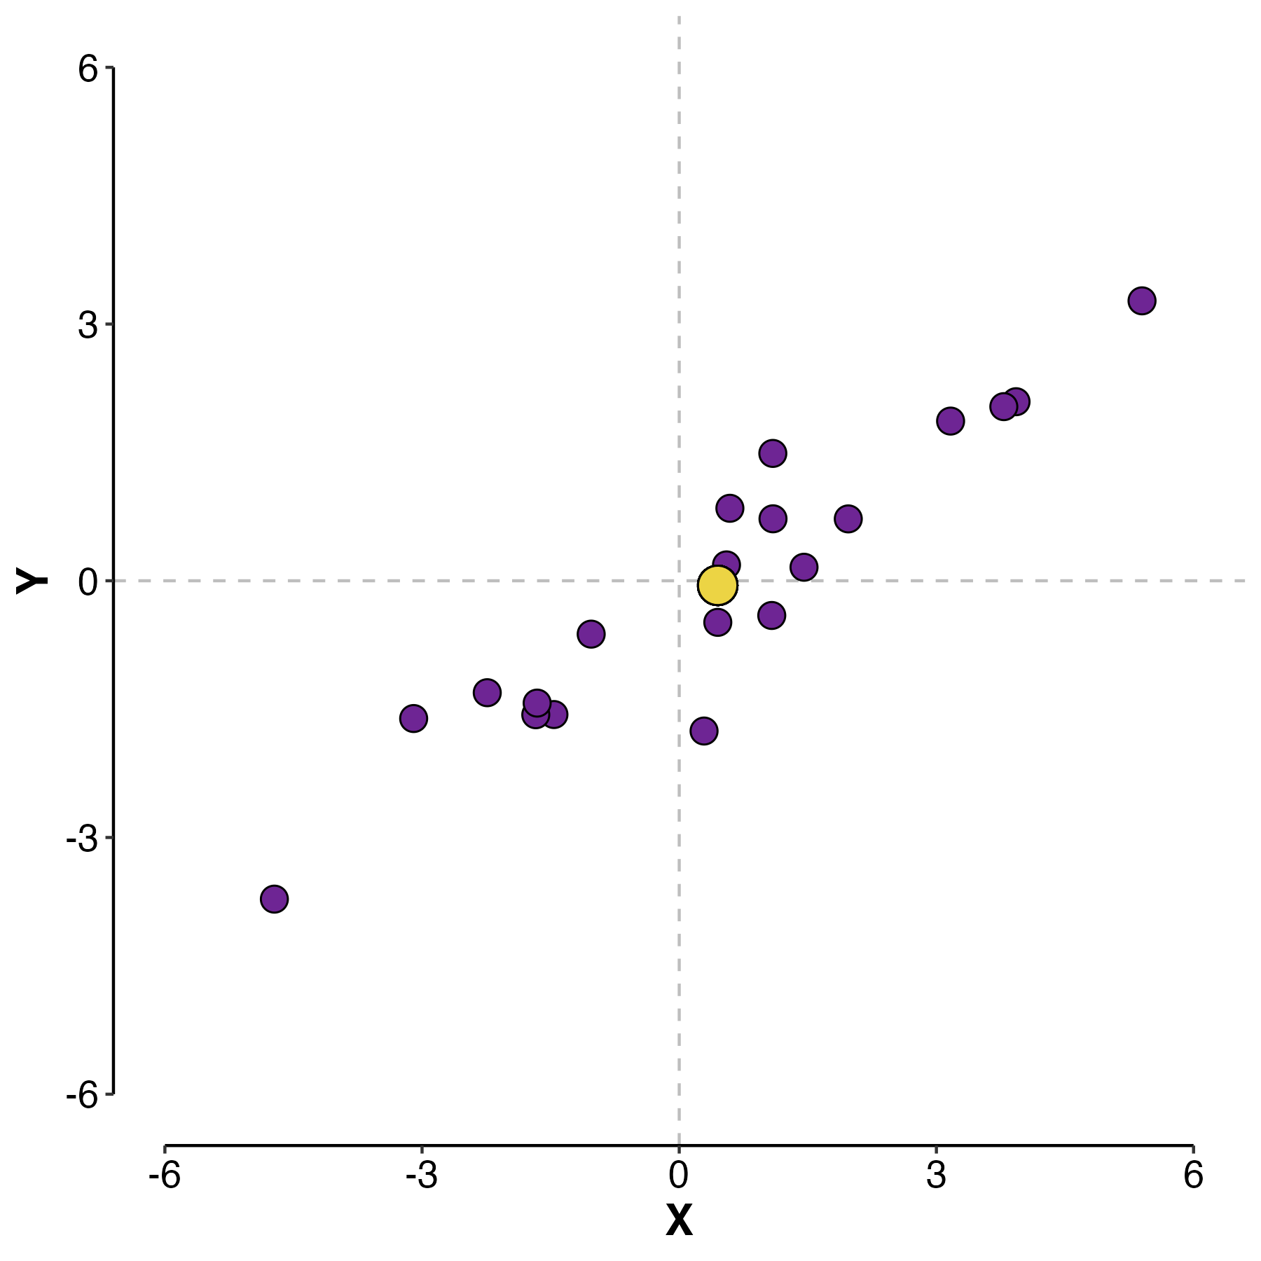
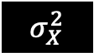
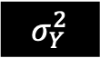
Developing an intuition for covariance
Also called the eigenvector of this covariance matrix
Maximizes variance
$$σ_{X}^{2}$$ | $$σ_{X,Y}$$
$$σ_{X,Y}$$ | $$σ_{Y}^{2}$$
$$σ_{Y}^{2}$$
6 | 4
4 | 3
Data point
Mean
$$σ_{X}^{2}$$

Slide 39
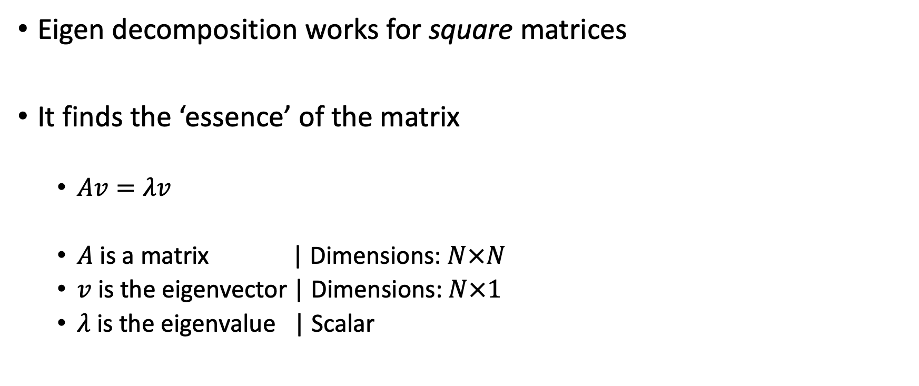
Intuition for eigen decomposition
Eigen decomposition works for square matrices
It finds the ‘essence’ of the matrix
$Av=λv$
$A$ is a matrix | Dimensions: $N×N$
$v$ is the eigenvector | Dimensions: $N×1$
$λ$ is the eigenvalue | Scalar

Slide 40
Why care about eigen decomposition?
Genomic data can be large and matrix multiplication is expensive
Let’s walk through it:
Our genomic data are stored as a matrix where:
Rows: Individuals
Columns: SNPs
# SNPs >> # Individuals

Slide 41
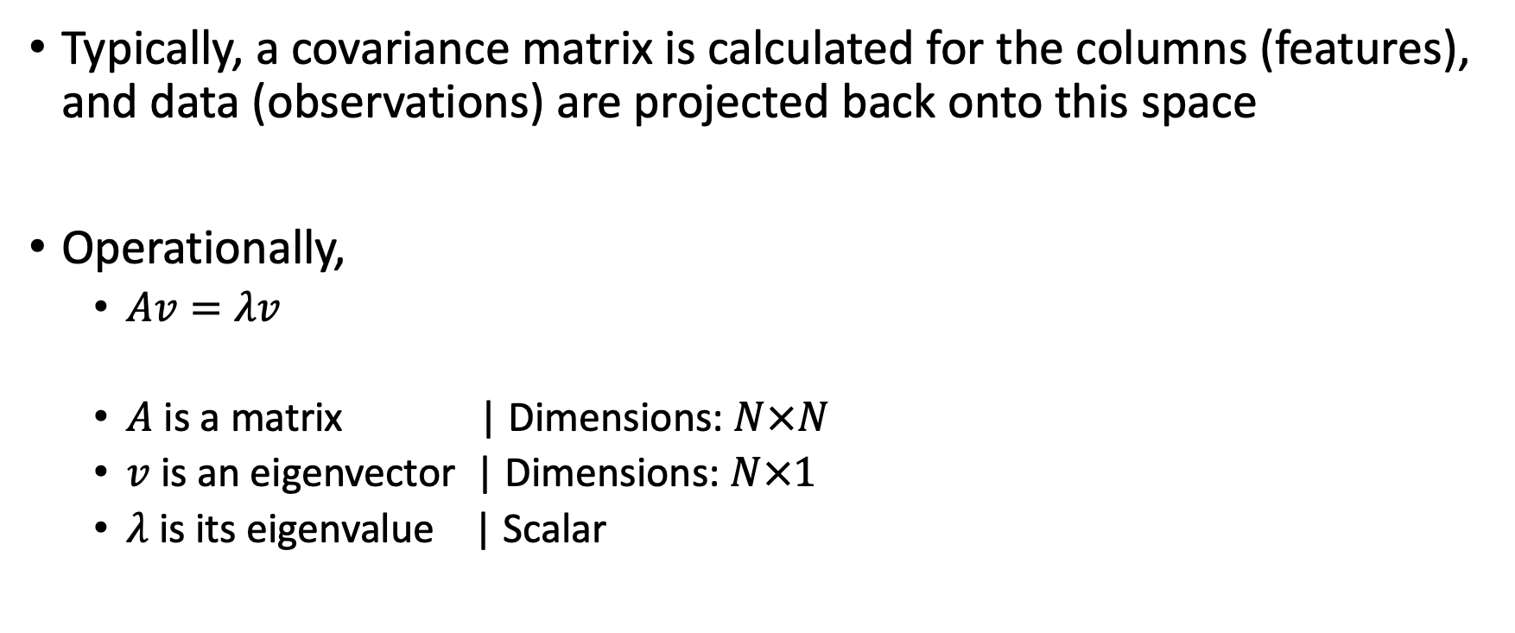
Why care about eigen decomposition?
Typically, a covariance matrix is calculated for the columns (features), and data (observations) are projected back onto this space
Operationally,
$Av=λv$
$A$ is a matrix | Dimensions: $N×N$
$v$ is an eigenvector | Dimensions: $N×1$
$λ$ is its eigenvalue | Scalar
It’s this N that depends on which ‘dimension’ we calculate the covariance matrix for

Slide 42
Linear algebra to the rescue!
 | SNP 1 | SNP 2 | … | SNP K
Ind 1
Ind 2
…
Ind N
There’s a cool trick where we can transpose the input matrix and still get the right eigenvalue and eigenvectors
This is variously called the ‘Gram Trick’ or the ‘Kernel Trick’
Hence – the first step to performing a dimensionality reduction is calculating a covariance matrix across all samples
Transpose
 | Ind 1 | Ind 2 | … | Ind K
SNP 1
SNP 2
…
SNP N

Slide 43
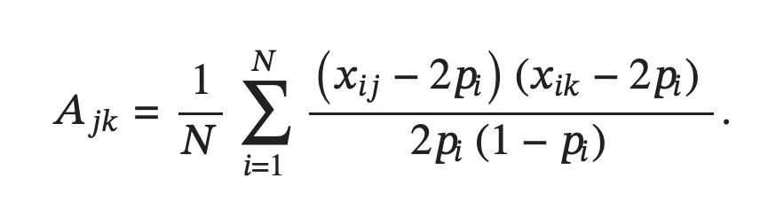
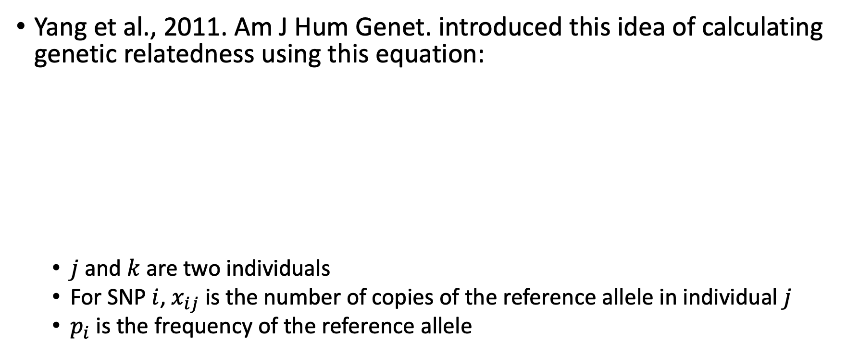
Genetic relatedness matrices (GRMs)
Yang et al., 2011. Am J Hum Genet. introduced this idea of calculating genetic relatedness using this equation:
$j$ and $k$ are two individuals
For SNP $i$, $x_{ij}$ is the number of copies of the reference allele in individual $j$
$p_{i}$ is the frequency of the reference allele

Slide 44
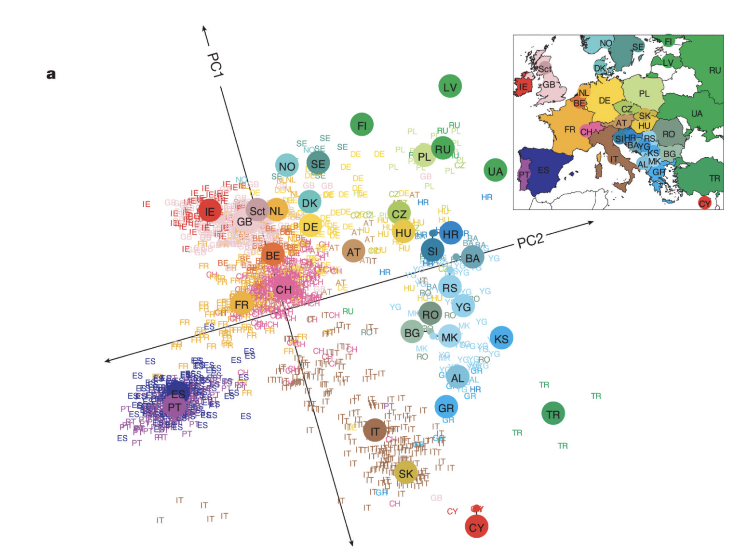
Principal Components Analysis to visualize diversity in lower dimensions
PCA is a popular linear dimensionality reduction algorithm that captures the largest variation in the data
Novembre et al., 2008. Nature.

Slide 45
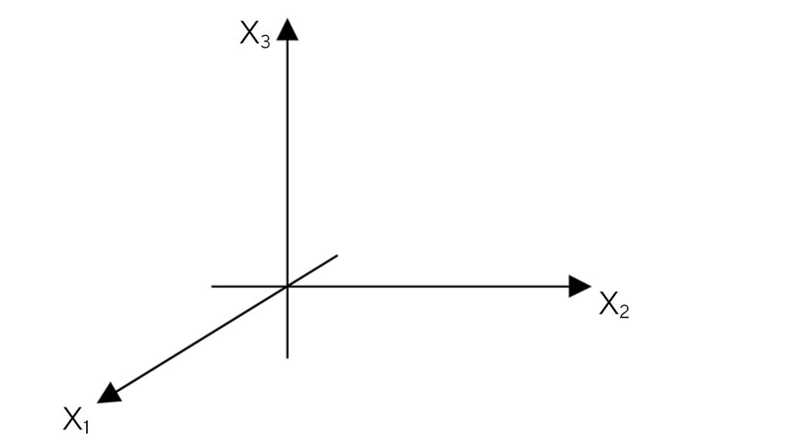
Dimensionality reduction with PCA
PCA finds lines, planes and hyper-planes in the K-dimensional space that approximate the data as well as possible
Let’s try to look at a 3-dimensional space
Images from Sartorius

Slide 46
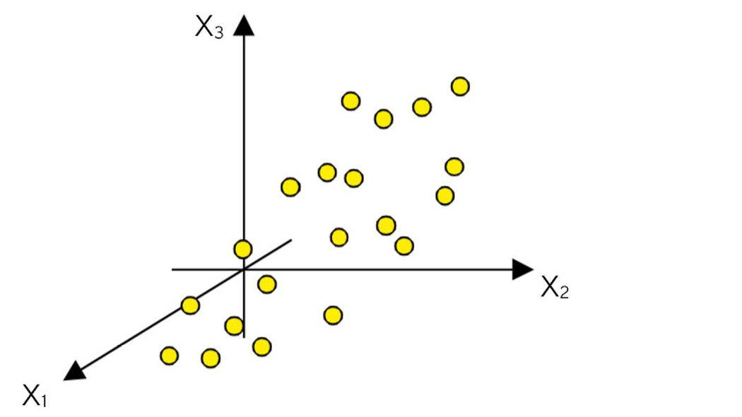
Dimensionality reduction with PCA
PCA finds lines, planes and hyper-planes in the K-dimensional space that approximate the data as well as possible
Let’s try to look at a 3-dimensional space
Images from Sartorius

Slide 47
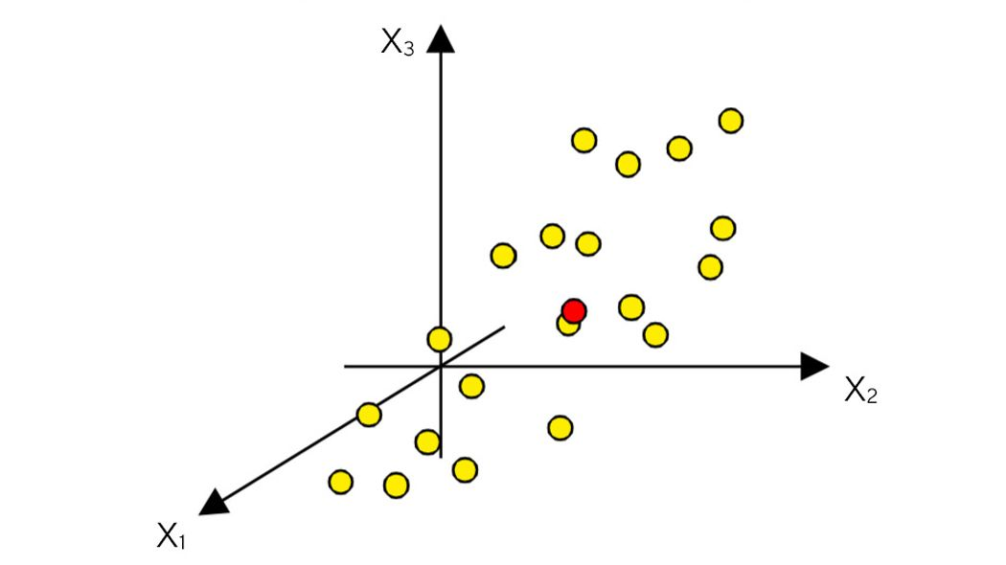
Dimensionality reduction with PCA
Mean centering:
The coordinate system is adjusted such that the origin coincides with the mean of the data
Images from Sartorius

Slide 48
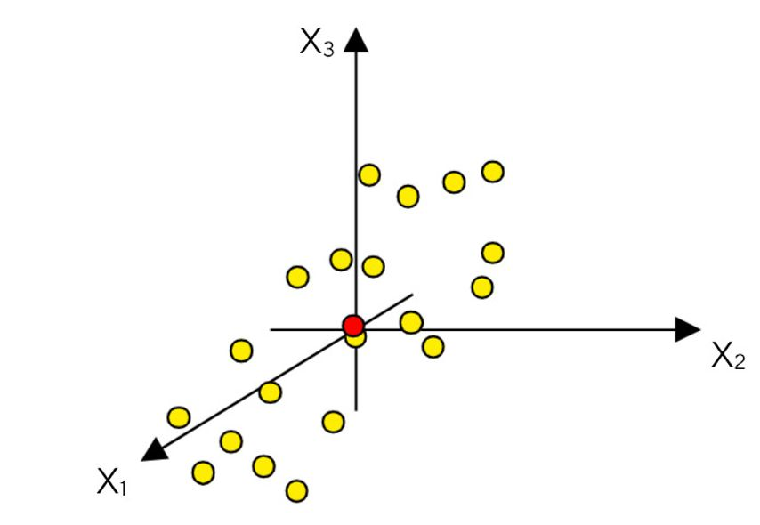
Dimensionality reduction with PCA
Mean centering:
The coordinate system is adjusted such that the origin coincides with the mean of the data
Images from Sartorius

Slide 49
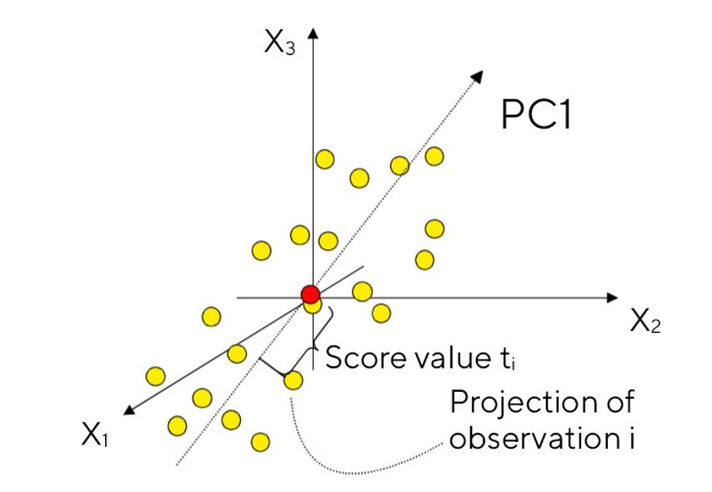
Dimensionality reduction with PCA
The first PC is computed as the best fit line using least squares
All points can be projected onto this line
Images from Sartorius

Slide 50
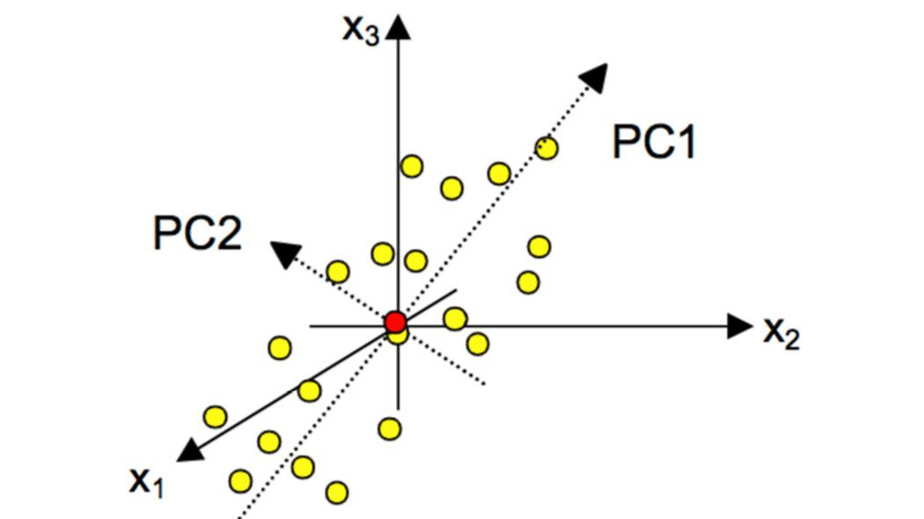
Dimensionality reduction with PCA
The next PC is identified as an orthogonal line to the the first PC
Images from Sartorius

Slide 51
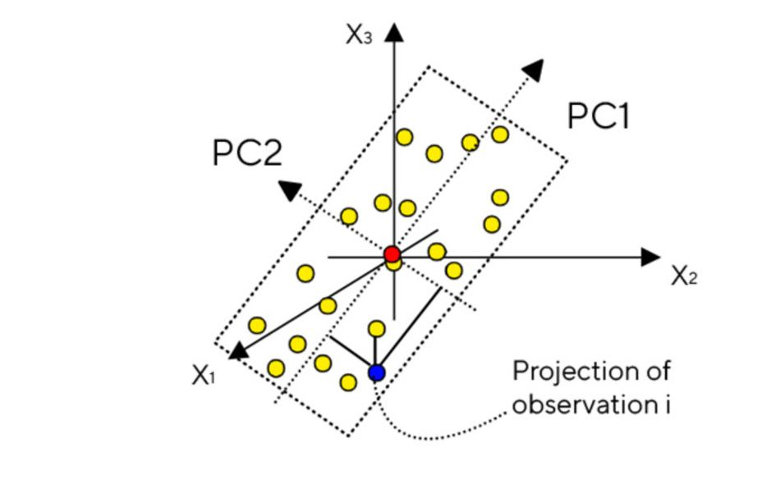
Dimensionality reduction with PCA
All points can be projected on this plane to preserved as much variance, while reducing dimensions
Images from Sartorius

Slide 52
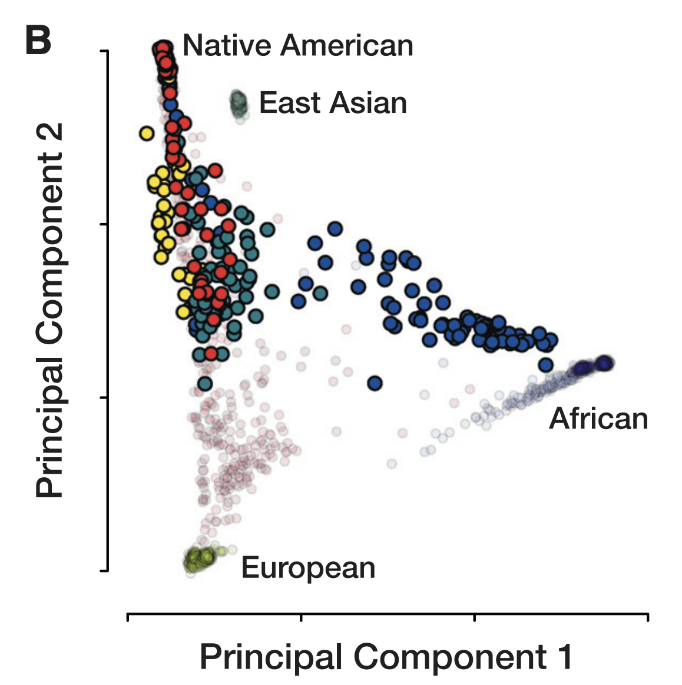
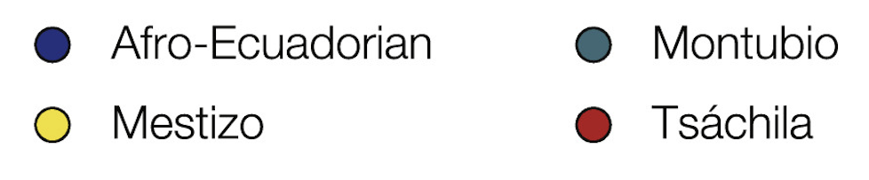
Global genetic diversity characterized using genomic data
Bright points are populations from Ecuador
Translucent points are reference populations
Nagar et al., 2021. HGG Advances.

Slide 53
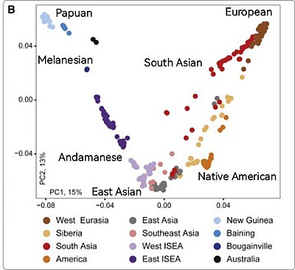
Global genetic diversity characterized using genomic data
Jacobs et al., 2019. Cell.

Slide 54
Importance of genetics in health disparities research
Unmeasured genetic factors are likely to be a source of hidden confounding in observational studies of health disparities that focus on social determinants of health
Particularly true for studies of health differences between racial and ethnic groups that differ with respect to both the social environment and their genetic background

Slide 55
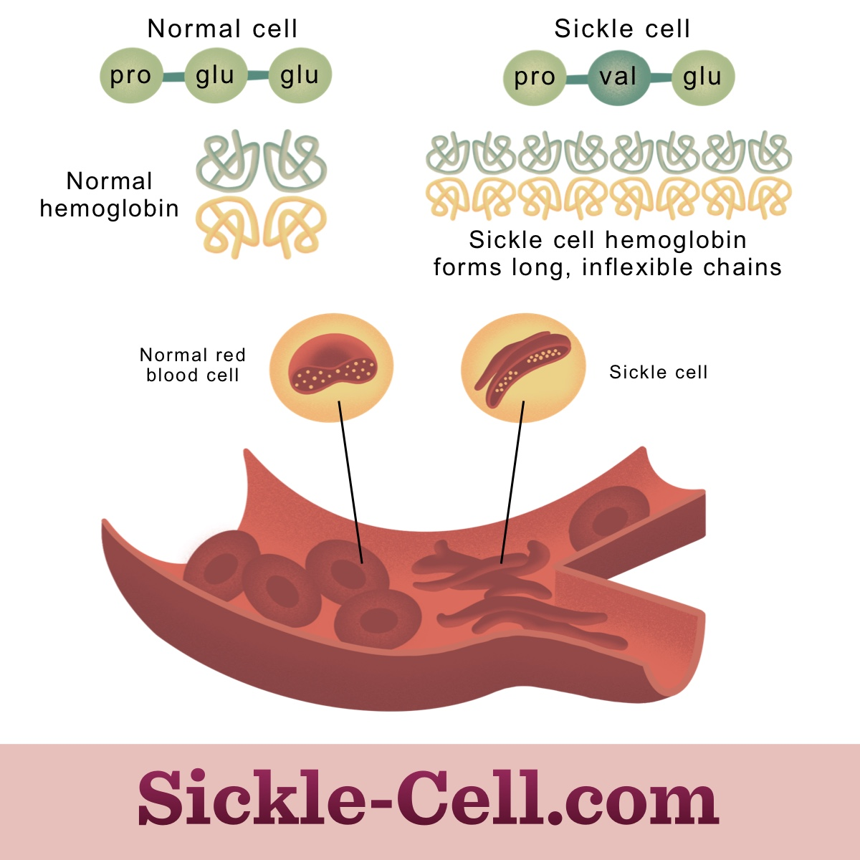
Thought experiment (with data): sickle cell anemia
Genetic disease caused by mutation in the sixth codon of the Beta-Globin gene (HBB)
Health disparity – prevalence difference between Black and White ethnic groups
HBB mutation highly penetrant – expected to cause disease irrespective of a patient’s social environment

Slide 56
Thought experiment (with data): sickle cell anemia
Assume no a priori knowledge of the genetic etiology of sickle cell
Treat as a health disparity to be investigated using an observational study design focused on social determinants of health
Townsend deprivation index (TDI) – composite, place-based metric of socioeconomic deprivation

Slide 57
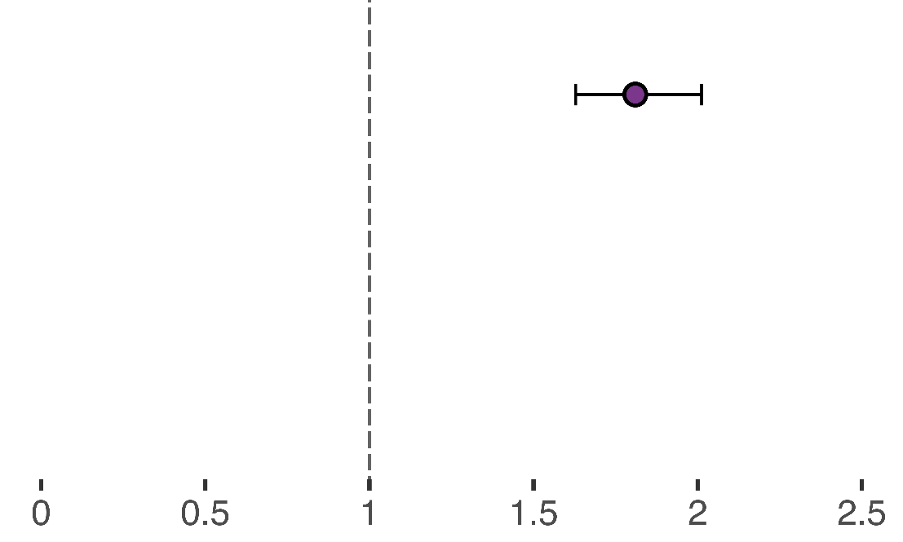
Social determinants only
Base Model: SCA ~ SED + Age + Sex
Association between sickle cell anemia (SCA; outcome) & socioeconomic deprivation (SED; predictor), age & sex (covariates)
Predictor | Odds ratio | Odds ratio (CI) | P-value
SED: Townsend Index (unadjusted) |  | 1.81 (1.63,2.01) | <2 x 10⁻¹⁶

Slide 58
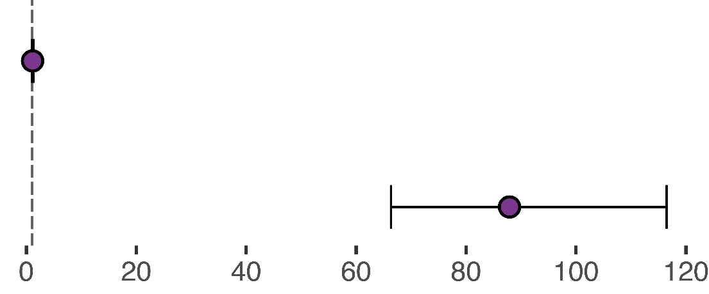
Social determinants + genetics
Genetics Adjusted Model: SCA ~ SED + Genetics + Age + Sex
Association between sickle cell anemia (SCA; outcome) & socioeconomic deprivation (SED; predictor), genetics (HBB-rs334), age & sex (covariates)
Predictor | Odds ratio | Odds ratio (CI) | P-value
SED: Townsend Index (genetics adjusted) |  | 1.14 (1.00,1.29) | 5.6 x 10⁻²
Genetics: HBB-rs334 |  | 87.90 (66.34, 11.47) | <2 x 10⁻¹⁶

Slide 59
Why is genetic diversity important for health disparities research?
Considering both together – genetics and social determinants – and their interplay to study health disparities can enable us to first characterize and then to ameliorate them

